Slide 1
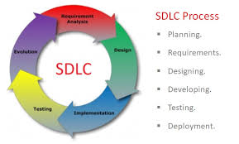
What is SDLC?(Application Lifecycle Management)
The software development lifecycle (SDLC) outlines several tasks required to build a software application. The development process goes through several stages as developers add new features and fix bugs in the software.
The details of the SDLC process vary for different teams. However, we outline some common SDLC phases below.

Slide 2
SDLC Methodoligies
Waterfall model
Spiral/iterative model
V- model
Prototype model
Hybrid model
Agile model

Slide 3
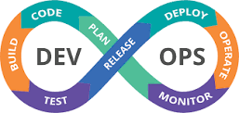
What is devops?
DevOps is about removing the barriers between two traditionally solid teams, development and operations. In some organizations, there may not even be separate development and operations teams; engineers may do both. With DevOps, the two teams work together to optimize both the productivity of developers and the reliability of operations.

Slide 4
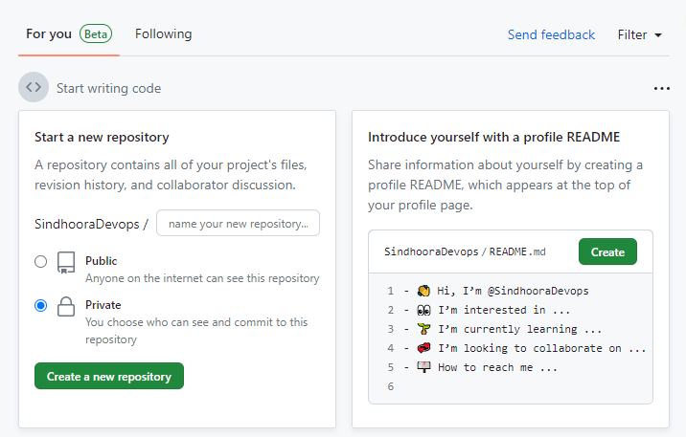
Create an Account in Github

Slide 5
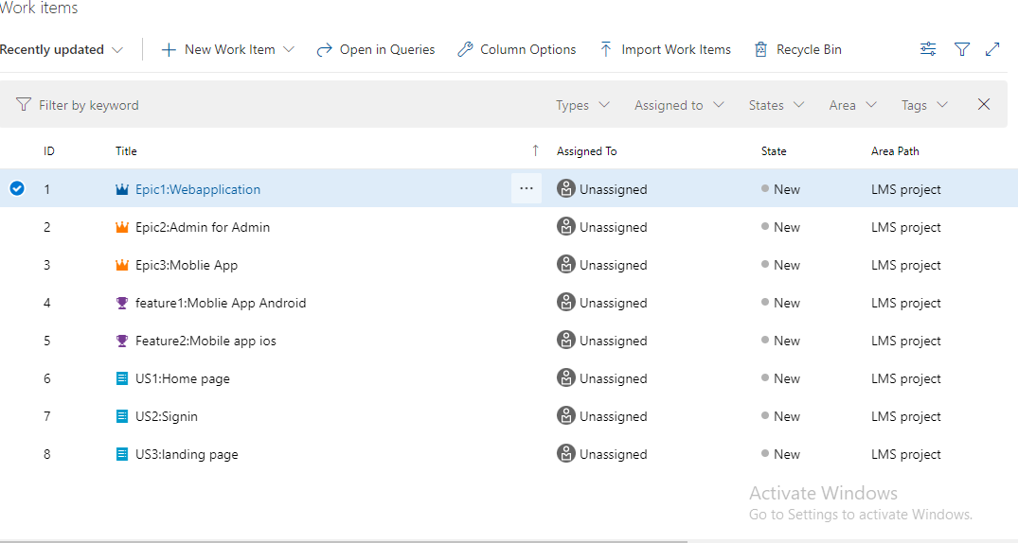
Create an account in Azure

Slide 6
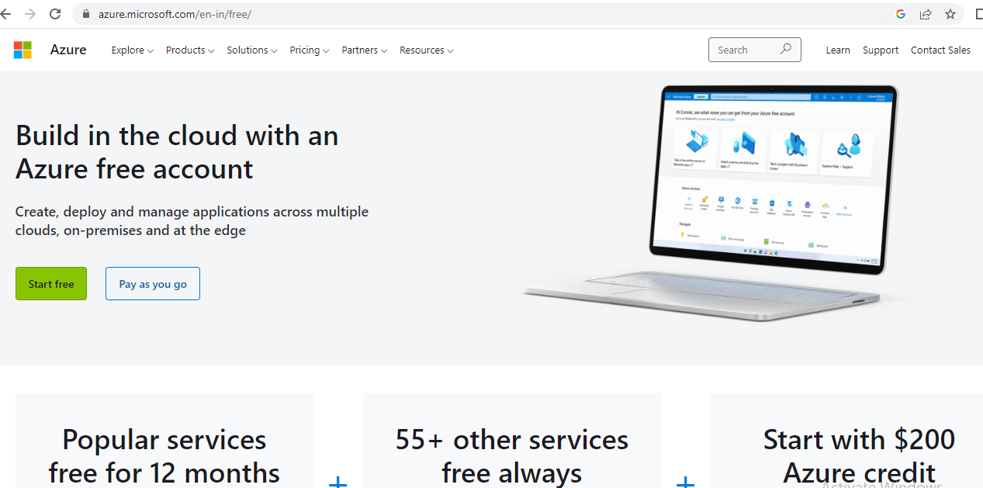
Azure free Account

Slide 7
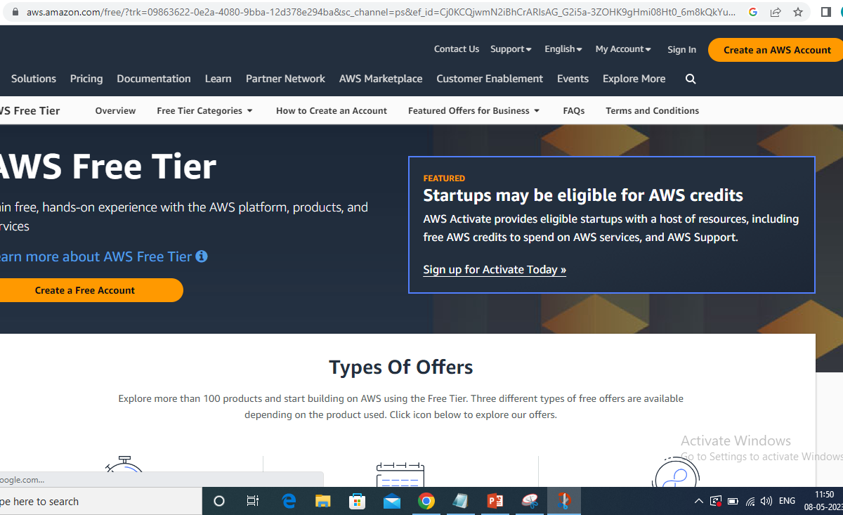
AWS Amazon free account

Slide 8
What is EC2
It is one of the most popular AWS service.
EC2=Elastic Compute Cloud=Infrastructure as a service.
Using Amazon EC2 eliminates your need to invest in hardware up front, so you can develop and deploy applications faster.
You can use Amazon EC2 to launch as many or as few virtual servers as you need, configure security and networking, and manage storage.

Slide 9
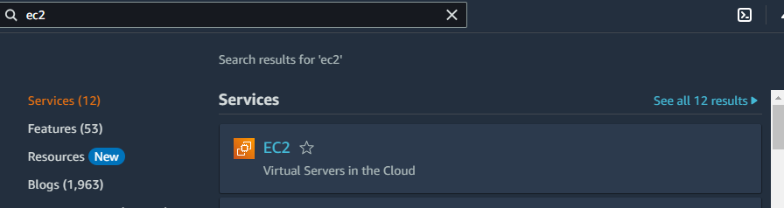

How to create and connect an instance we need to login to the console and go to search for EC2

Slide 10
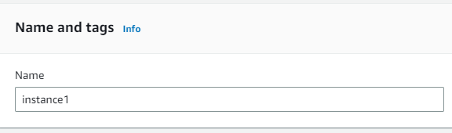
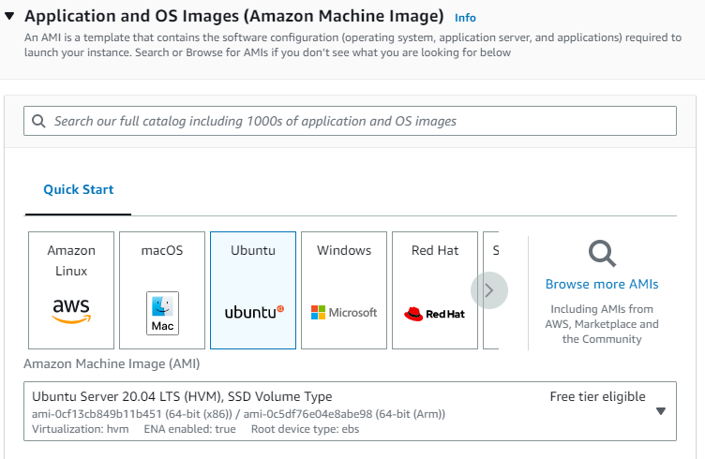

Slide 11
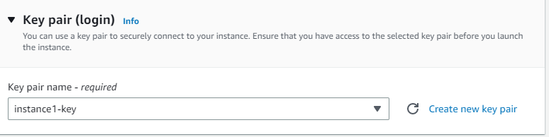
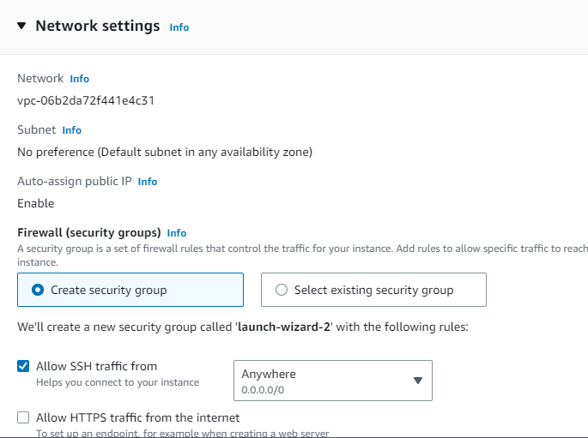

Slide 12

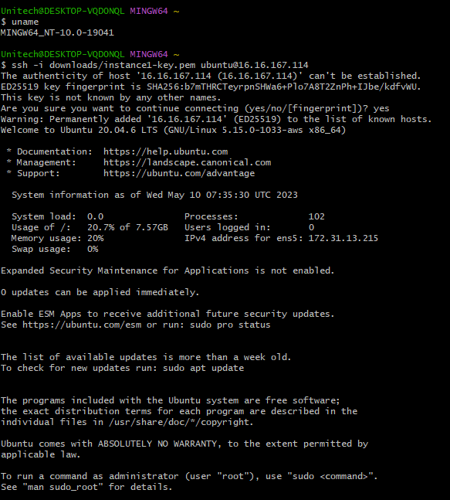

Slide 13
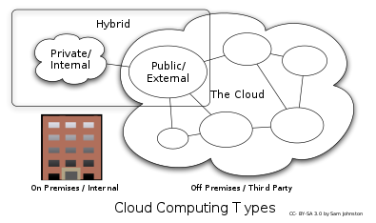
What is cloud computing?
Cloud computing refers to on demand availability of computer power, Database storage, applications, servers and other IT services through a cloud platform(AWS, Azure ,GCP etc) via internet with pay-as-you-go pricing.
Types of cloud computing
Public cloud: In the public cloud model, a third-party cloud service provider delivers the cloud service over the internet. Public cloud services are sold on demand, typically by the minute or hour, though long-term commitments are available for many services. Customers only pay for the central processing unit cycles, storage or bandwidth they consume. Leading public CSPs include AWS, Microsoft Azure, IBM and Google Cloud Platform (GCP), as well as IBM, Oracle and Tencent.
Private cloud: Private cloud services are delivered from a business data center to internal users. With a private cloud, an organization builds and maintains its own underlying cloud infrastructure. This model offers the versatility and convenience of the cloud, while preserving the management, control and security common to local data centers. Common private cloud technologies and vendors include VMware and OpenStack.

Slide 14
Hybrid cloud: A hybrid cloud is a combination of public cloud services and an on-premises private cloud, with orchestration and automation between the two.
Types of cloud computing services
Infrastructure as a Service (IaaS): IaaS contains the basic building blocks for cloud IT. It typically provides access to networking features, computers (virtual or on dedicated hardware), and data storage space. IaaS gives you the highest level of flexibility and management control over your IT resources. It is most similar to the existing IT resources with which many IT departments and developers are familiar.
Platform as a Service (PaaS): PaaS removes the need for you to manage underlying infrastructure (usually hardware and operating systems), and allows you to focus on the deployment and management of your applications. This helps you be more efficient as you don’t need to worry about resource procurement, capacity planning, software maintenance, patching, or any of the other undifferentiated heavy lifting involved in running your application.
Software as a Service (SaaS):SaaS provides you with a complete product that is run and managed by the service provider. In most cases, people referring to SaaS are referring to end-user applications (such as web-based email). With a SaaS offering, you don’t have to think about how the service is maintained or how the underlying infrastructure is managed. You only need to think about how you will use that particular software.

Slide 15
What is AWS ?
It is a web application that comprises and refers to a broad collection of services(EC2,VPA,IAM,DB etc) for managing amazon web services.
Applications of AWS
Storage and backup
Websites
Gaming
Database management
Email notifications

Slide 16
AWS Cloud Networking
AWS is a global infrastructure where data centers are present throughout the world.
VPC: Virtual Private Cloud is an on demand configurable pool of shared resources allocated within a public cloud environment providing a certain level of isolation between different organizations using resources. A virtual private cloud (VPC) is a secure, isolated private cloud hosted within a public cloud. VPC customers can run code, store data, host websites, and do anything else they could do in an ordinary private cloud, but the private cloud is hosted remotely by a public cloud provider. (Not all private clouds are hosted in this fashion).
AWS VPC: It is a service that lets customer provision a logically isolated section of the AWS cloud where you can launch AWS resources (Database, storage, servers etc)in a virtual network that you define.
VPC Components:
Internet gateway
Rout table
Security group
Subnets
Network Access control list(NACl)

Slide 17
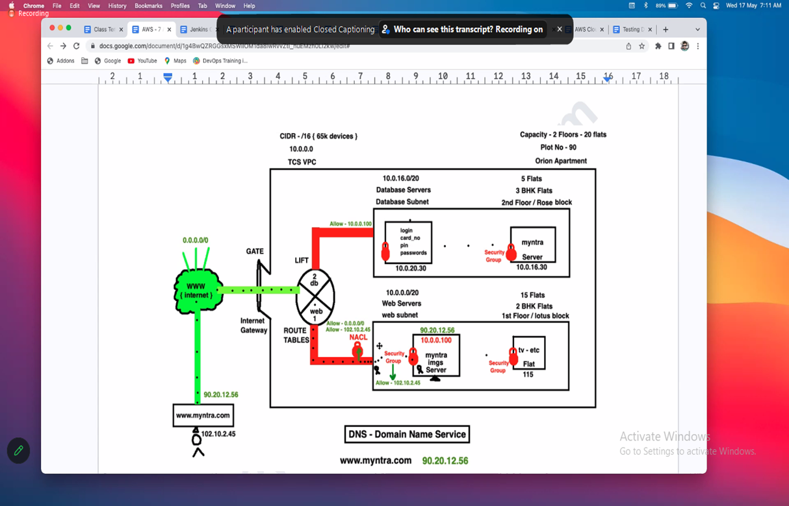

Slide 18
Thank you

